Slide 1

Capstone Project Presentation
Group Member
Kohsin Chen
Zerui Zhang
Zheng Zhang
Bingshen Yang
Greenspace Mental Health
Group 3
Therapeutic Alliance
May 7, 2024

Slide 2

Agenda
01
02
03
04
05
What is mental diseases
Introduction
Methods
Dataset
Timeline

Slide 3

Mental Diseases
Mental diseases, or disorders, are conditions that affect a person’s thinking, feeling, mood, or behavior.
These can include depression, anxiety disorders, schizophrenia, eating disorders, and addictive behaviors.
Notes:
A patient will be assigned to a therapist, and they will set up their goals together, discuss what is the appropriate intervention for the patient, such as pharmacotherapy, psycotherapy or lifestyle adjustment.

Slide 4

What is Therapeutic Alliance?
collaborative and affective bond between a therapist and a patient
plays a pivotal role and predictor in the efficacy of psychological treatments
Notes:
A strong therapeutic alliance is characterized by trust, mutual understanding, and agreement on treatment goals between the therapist and the patient.

Slide 5

Flagging risky patients
Early identification of these individuals is vital for the timely adjustment of therapeutic strategies and interventions.
Enable healthcare providers to allocate the right resources efficiently, personalize care, and ultimately improve patient outcomes
Notes:
Furthermore, flagging risky patients is also an important issue.

Slide 6
Green Space Mental Health
Comprehensive Measurement Based Care (MBC) platform tailored for mental health professionals and clients.
Measurement-Based Care involves tracking client progress throughout treatment, using consistent Patient-Reported Outcome Measures (PROMS).
Notes:
Here why Greenspace comes

Slide 7
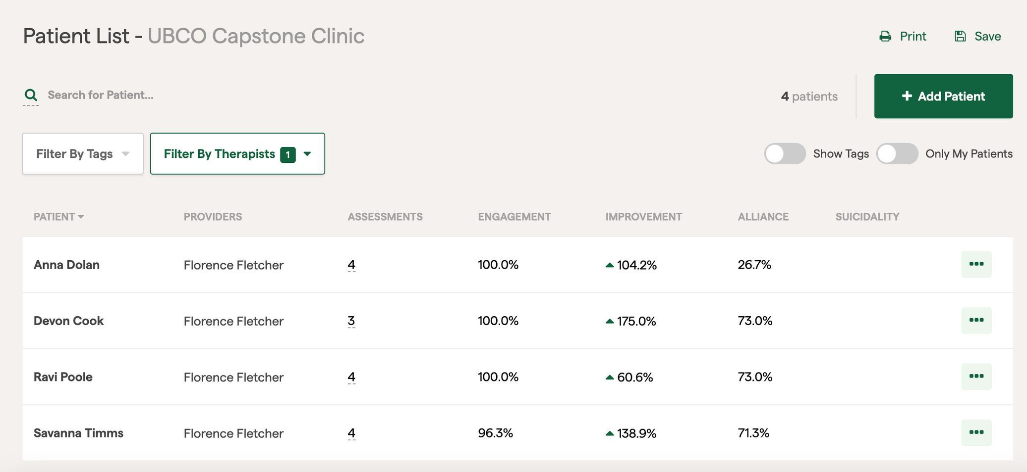
Demo

Slide 8
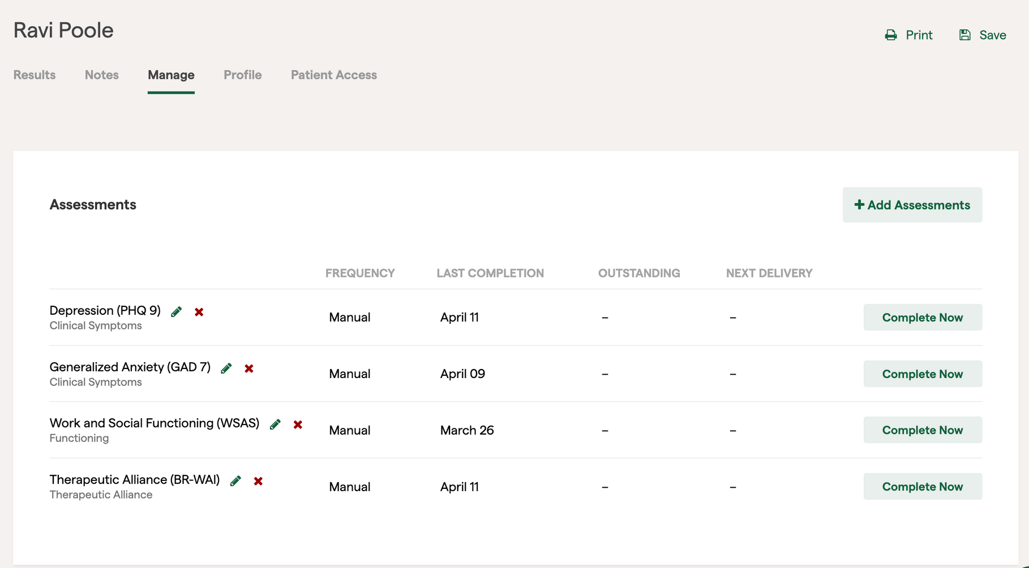
Demo

Slide 9

My therapist and I understand each other.
Therapeutic Alliance
Assessment
We have established a good understanding of the kind of changes that would be good for me.
1 = Strongly Disagree 2 = Disagree 3 = Neutral 4 = Agree 5 = Strongly Agree
I feel that my therapist appreciates me.
I believe the time my therapist and I are spending together is not spent efficiently.
I believe my therapist likes me.
Notes:
16 questions
It measure how the patient feel about the therapist.

Slide 10
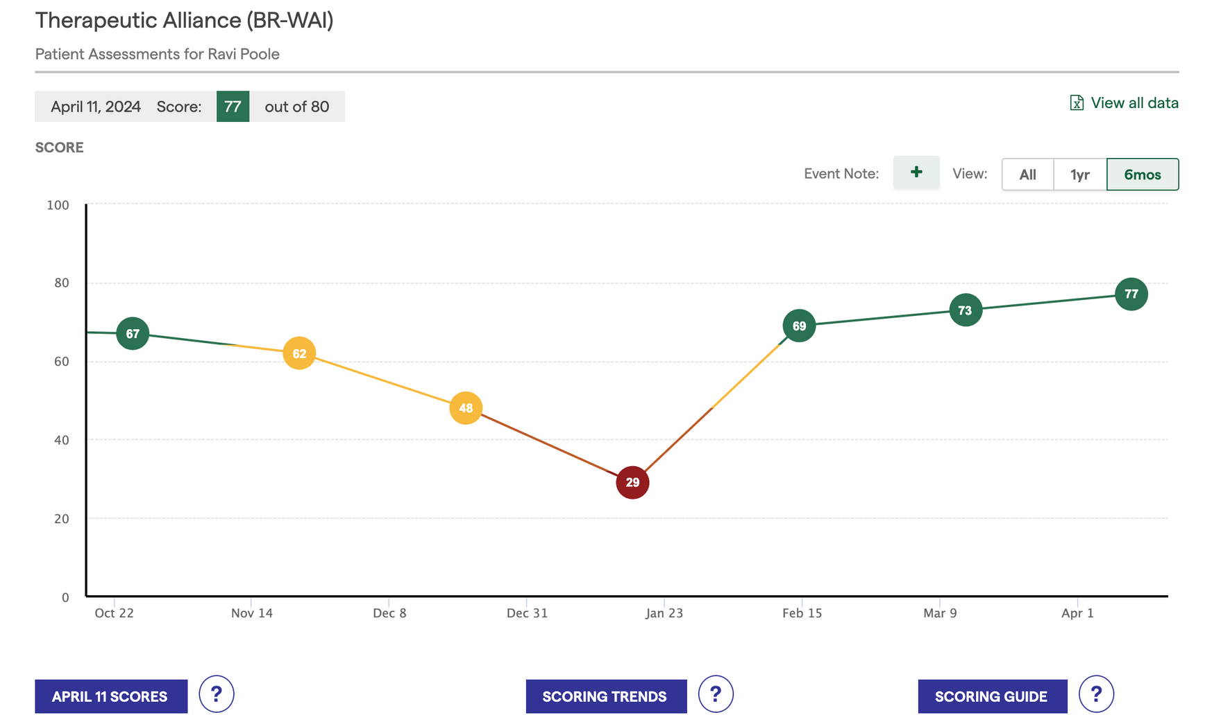
Demo

Slide 11
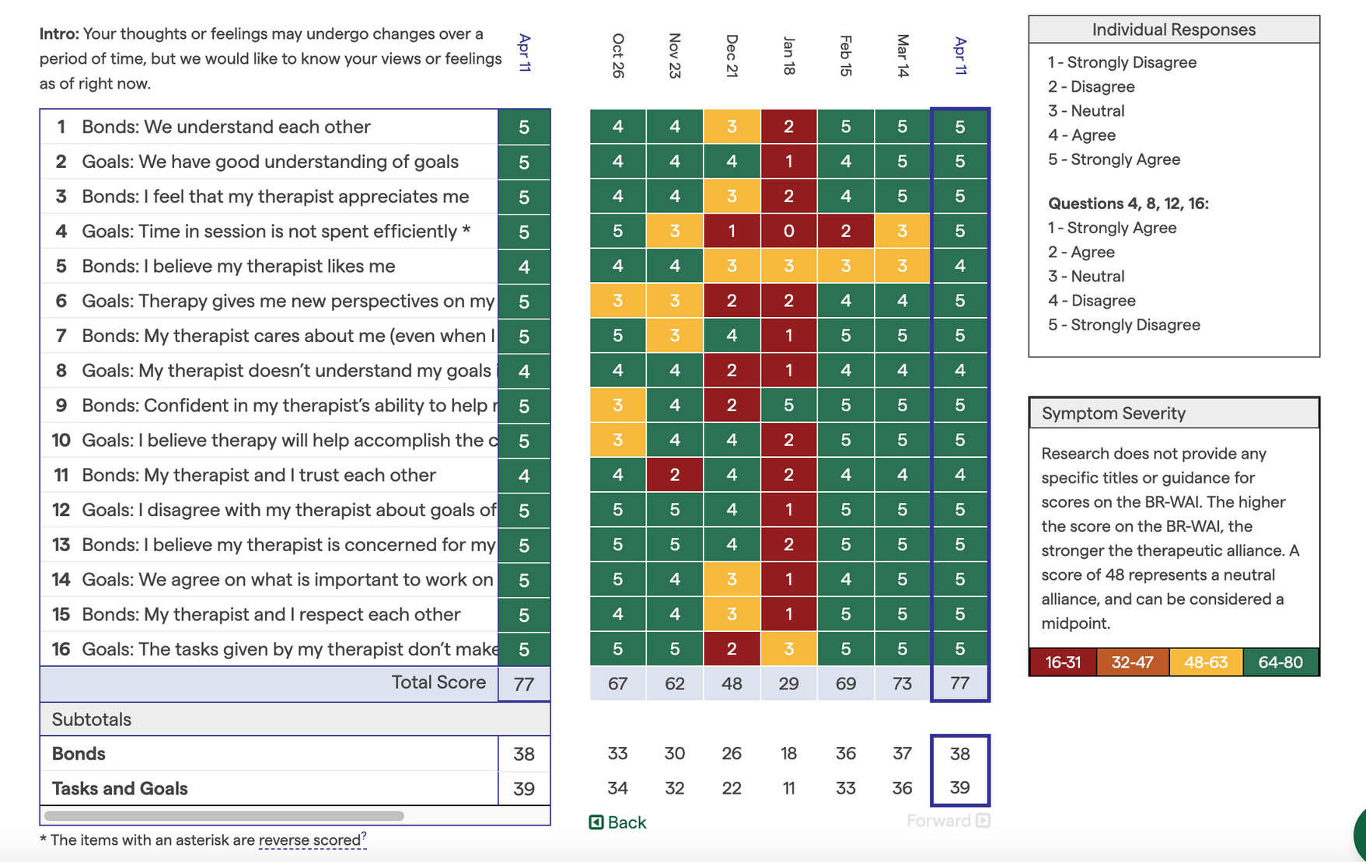
Demo

Slide 12
Problem Overview
Establishing and maintaining a robust therapeutic alliance can be challenging
intrinsic to the patient
inherent to the therapist
combination
Identifying risky patients
What’s the next action?
Notes:
Identify risky patients
It is better to provide therapist some insights what they should do next to improve patient outcome

Slide 13
Objectives
01
What factors predict or influence the Therapeutic Alliance between a patient and their therapist?
02
How can we identify and prioritize high-risk patients for therapists?
Notes:
What factors predict or influence relationship between a patient and their therapist, also known as Therapeutic Alliance? Using this information, can the system recommend a new therapist for the patient or make suggestions for the current therapist to improve Therapeutic Alliance?
A similar problem would be to determine if there are high risk patients that the therapist should focus on. A potential solution would be to come up with a way to sort risky patients, defined by worsening scores (positive or negative depending on assessment) or disengagement. Look for actionable insights for the therapist about what to do with these patients based on success of other actions and correlations.

Slide 14
Methods
Predictive Modeling
Classification Techniques
Regression Analysis
Random Forest
XGBoost
Logistic Regression
Support Vector Machine

Slide 15
Dataset Overview
ASSESSMENTS: details about various assessments assigned to patients
RESPONSES: patient’s responses to assigned assessments
PATIENTS: data on specific questions and interactions associated with patients
THERAPISTS: Therapeutic Alliance score

Slide 16

Interesting Features
Measuring the Quality of the Alliance
BR-WAI (Bonding-Relationship Working Alliance Inventory)
`THERAPEUTIC_ALLIANCE_SCORE`
Assigning Risk Levels to Patients
assessments result and treatment effection overtime
`SCORE_IMPROVEMENT`

Slide 17


Data Preparation
Data cleaning ensures accuracy, including validity checks and handling missing data.
Data integration combine tables using universal identifiers, simplifying access and analysis.

Slide 18
Deliverables:
Predictive Model Report
2. Recommendation System for Therapist Assignment
3. Actionable Insights Guide:

Slide 19

Schedule
Weekly Sprint Model
- Project Kickoff: April 29th
- Communication Plan: Weekly check-ins with
Mr. Nicholas Kwan every Thursday via Zoom,
team meetings every Wednesday and Saturday
- Starts May 5th, new sprint launches each Sunday
- Sprint 1 (May 5 - May 12): Explore the data
- Sprint 2 (May 13 - May 26): Set up the model
- Sprint 3 (May 27 - June 09): Analyze the result
- Sprint 4 (June 10 - June 29): Final report and presentation

Slide 20
Thank you

